Slide 1
Azure Document Intelligence
Zero to Hero Workshop

Slide 2
Prerequisites
Azure Subscription
Azure Resource Group
Azure Document Intelligence
Azure Computer Vision
Azure Storage Account

Slide 3
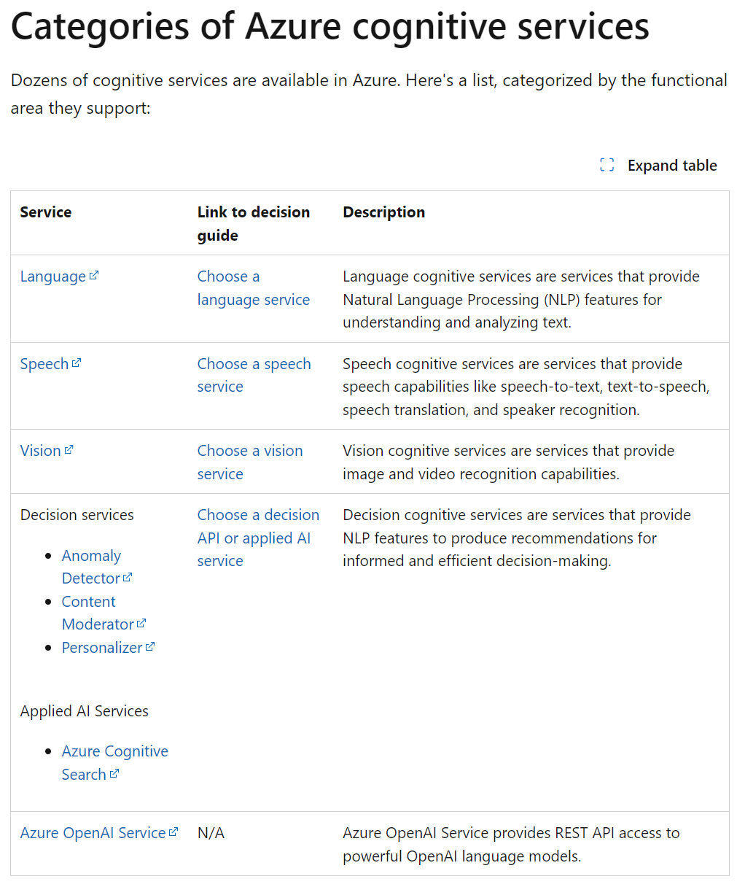
Overview
Link
Pricing
Notes:
https://learn.microsoft.com/en-us/azure/architecture/data-guide/technology-choices/cognitive-services

Slide 4
ID Document prebuilt model

Slide 5
On Azure
I used “North Europe” throughout
Create Resource Group
Create “Document Intelligence” Resource

Slide 6
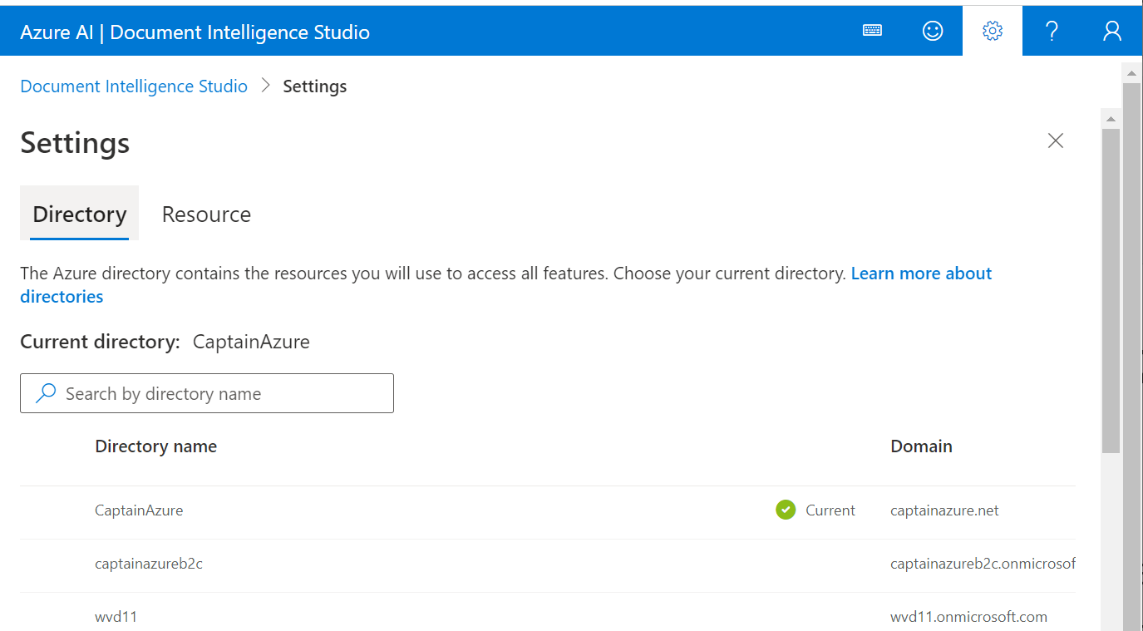
DI Studio –default enviroment

Slide 7
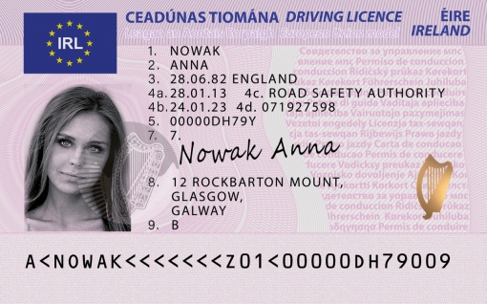
Irish Driving License
First Name: ANNA has confidence: 0.716
Last Name: NOWAK has confidence: 0.714
Document Number: 00000DH79Y has confidence: 0.858
Date of Birth: 1982-06-28 has confidence: 0.782
Date of Expiration: 2023-01-24 has confidence: 0.852
Address: AddressValue(
house_number=12,
po_box=None,
road=ROCKBARTON,
city=MOUNT, GLASGOW,
state=None,
postal_code=None,
country_region=None,
street_address=12 ROCKBARTON,
unit=None,
city_district=None,
state_district=GALWAY,
suburb=None,
house=None,
level=None) has confidence: 0.716

Slide 8
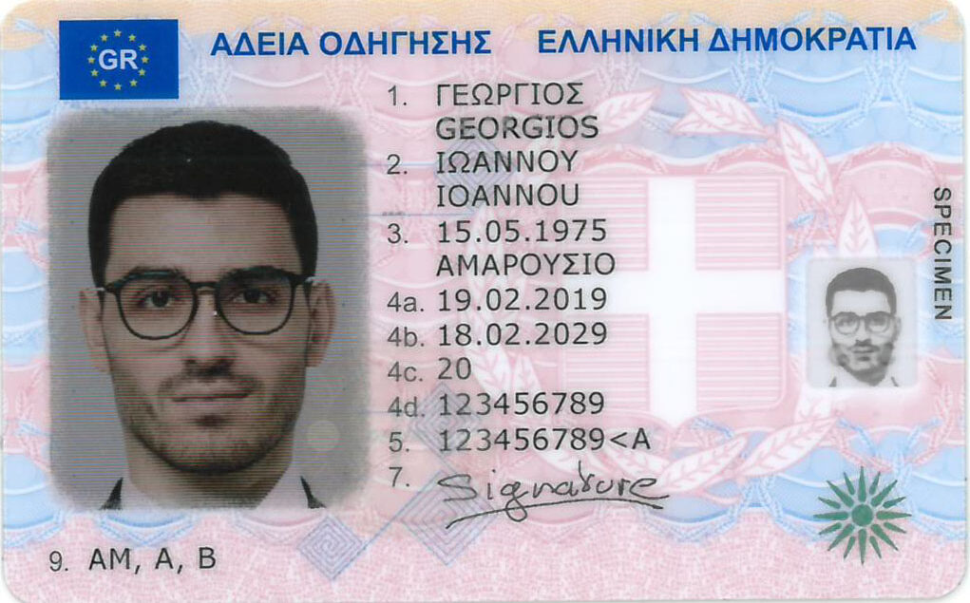
Greek Driving License
Will need to specify the correct locale:
fr_locale="el"
First Name: ΙΩΑΝΝΟΥ IOANNOU confidence: 0.649
Last Name: ΓΕΩΡΓΙΟΣ GEORGIOS confidence: 0.622
Document Number: 123456789<A confidence: 0.859
Date of Birth: 1975-05-15 has confidence: 0.858
Date of Expiration: 2029-02-18 has confidence: 0.86

Slide 9
Custom Document Format
Step by step guide

Slide 10
Number Plate Recognition

Slide 11
Prereq
Azure
Create “Computer Vision” service
Create Azure Machine Learning service
Dev Machine
The demo is using Anaconda notebooks
Alternatively
VS Code locally – requires Anaconda environment
VS Code on the web – requires Jupiter Server to run notebooks
Azure Machine Learning

Slide 12
https://github.com/nfmoore/automatic-number-plate-recognition-poc

Slide 13
Example on GitHub
Notes:
https://github.com/nfmoore/automatic-number-plate-recognition-poc

